Slide 1


Ant Colony Optimization Scheduling
By: Jaouaher Belgacem
Notes:
In meiner heutigen Präsentaiton werde ich meine Bachelorarbiet zum Thmea … Vorstellen.

Slide 2
Motivation
Why Ant Colony Optimization?
2

Slide 3
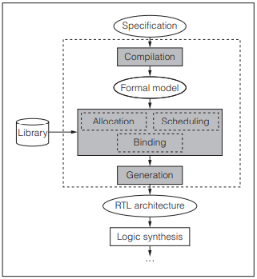
Ant Colony Optimization Scheduling
I. Introduction
What is HLS?
[1]

Slide 4
Ant Colony Optimization Scheduling
I. Introduction
What is a Hardware/Software Codesign?
It sums up in putting the effort of designing hardware and software elements collaborating into one single design.

Slide 5
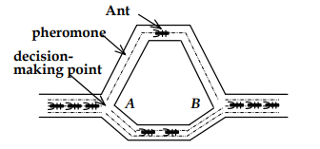
Ant Colony Optimization Scheduling
II. Foundations
ACO
[2]

Slide 6
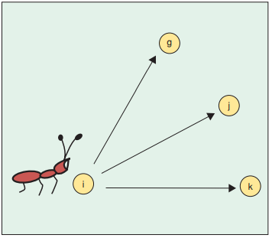
Ant Colony Optimization Scheduling
II. Foundations
TSP problem and ACO
[3]

Slide 7

Ant Colony Optimization Scheduling
II. Foundations
ACO algorithm flow
[4]

Slide 8
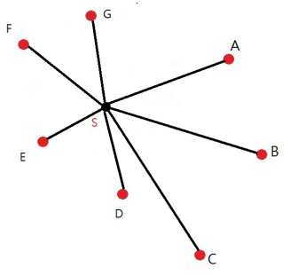
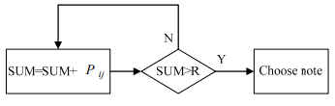
Ant Colony Optimization Scheduling
II. Foundations
ACO path possibilities
[4]
[4]

Slide 9
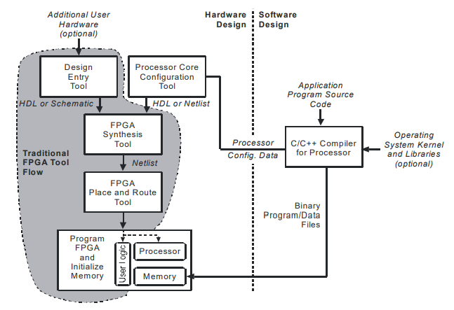
Ant Colony Optimization Scheduling
III. ACO and HLS integration
SOPC
[5]

Slide 10
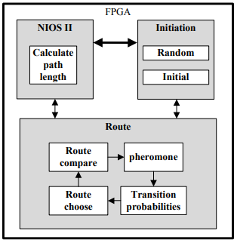
Ant Colony Optimization Scheduling
ACO and HLS integration
ACO Mapping On FPGA:
[4]

Slide 11
Conclusion
Ant Colony Optimization Scheduling
Notes:
Damit bin ich am Ende meines Referates. Ich danke Ihnen für Ihre Aufmerksamkeit.

Slide 12

Questions?
Ant Colony Optimization Scheduling
12

Slide 13
References
Ant Colony Optimization Scheduling
[1]: P. Coussy, D. D. Gajski, M. Meredith and A. Takach, ”An Introduction to High-Level Synthesis,” in IEEE Design & Test of Computers, vol. 26, no. 4, pp. 8-17, July-Aug. 2009, doi: 10.1109/MDT.2009.69.
[2]: Enxiu Chen and Xiyu Liu, ”Multi-Colony Ant Algorithm,” in Ant Colony Optimization Methods and Applications, A. Ostfeld, Ed. Rijeka, Croatia: InTech, 2011, pp. 3-6.
[3]: M. Dorigo, M. Birattari and T. Stutzle, ”Ant colony optimization,” in IEEE Computational Intelligence Magazine, vol. 1, no. 4, pp. 28-39, Nov. 2006, doi: 10.1109/MCI.2006.329691.
[4]: Shih-An Li, Min-Hao Yang, Chung-Wei Weng, Yi-Hong Chen, Chia- Hung Lo, and Ching-Chang Wong. ”Ant colony optimization algorithm design and its FPGA implementation,” 2012 International Symposium
on Intelligent Signal Processing and Communications Systems, Tamsui, Taiwan, 2012, pp. 262-265, doi: 10.1109/ISPACS.2012.6473492.
[5]: T. S. Hall and J. O. Hamblen, ”Using system-on-a-programmable-chip technology to design embedded systems,” in Proceedings of the IEEE, vol. 13, no. 3, pp. 142-152, Sep. 2006.

